Slide 1

Predictive Analytics in Business (BUAN 448–Data Mining)
BUAN 488 – Fall 2022 – Dr. Davoodi

Slide 2
Agenda
Core Ideas in Data Mining
Supervised Learning & Unsupervised Learning

Slide 3
Core Ideas in Data Mining

Slide 4
Core Ideas in Data Mining
Data mining is the process of finding anomalies, patterns, and correlations, (knowledge discovery), within large data sets to predict outcomes and make well-informed decisions.
Classification
Prediction
Association Rules & Recommendation System
Data Exploration (Data Reduction & Visualization)
https://www.sas.com/en_us/insights/analytics/data-mining.html

Slide 5
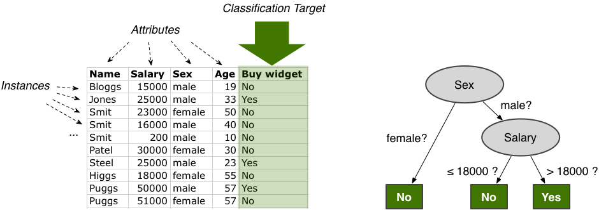
Classification
Source: https://fluxicon.com

Slide 6
Classification
Goal: Predict categorical target (outcome) variable
Examples: Purchase/no purchase, fraud/no fraud, creditworthy/not creditworthy…
Each row is a case (customer, tax return, applicant)
Each column is a variable
Target variable is often binary (yes/no)

Slide 7
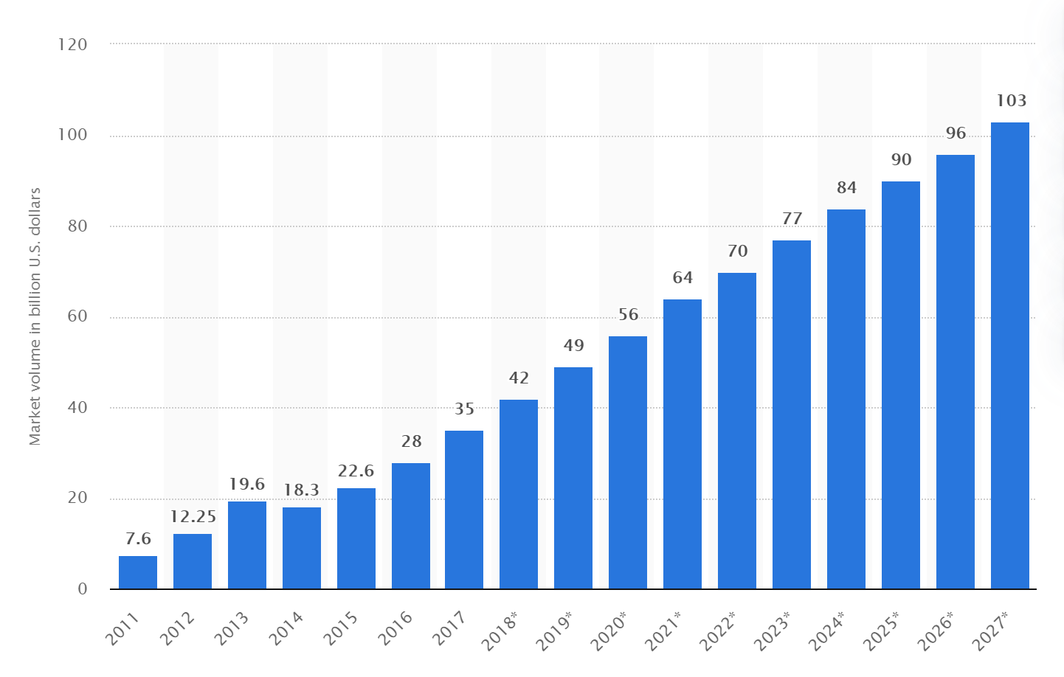
Prediction
Big data market size revenue forecast worldwide from 2011 to 2027
(in billion U.S. dollars)
Source: Statista

Slide 8
Prediction
Goal: Predict numerical target (outcome) variable
Examples: sales, revenue, performance
Each row is a case (customer, tax return, applicant)
Each column is a variable

Slide 9
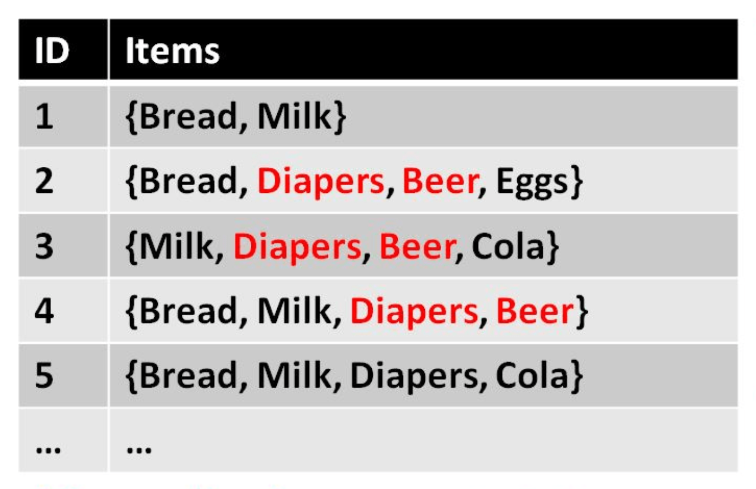

Association Rules

Slide 10

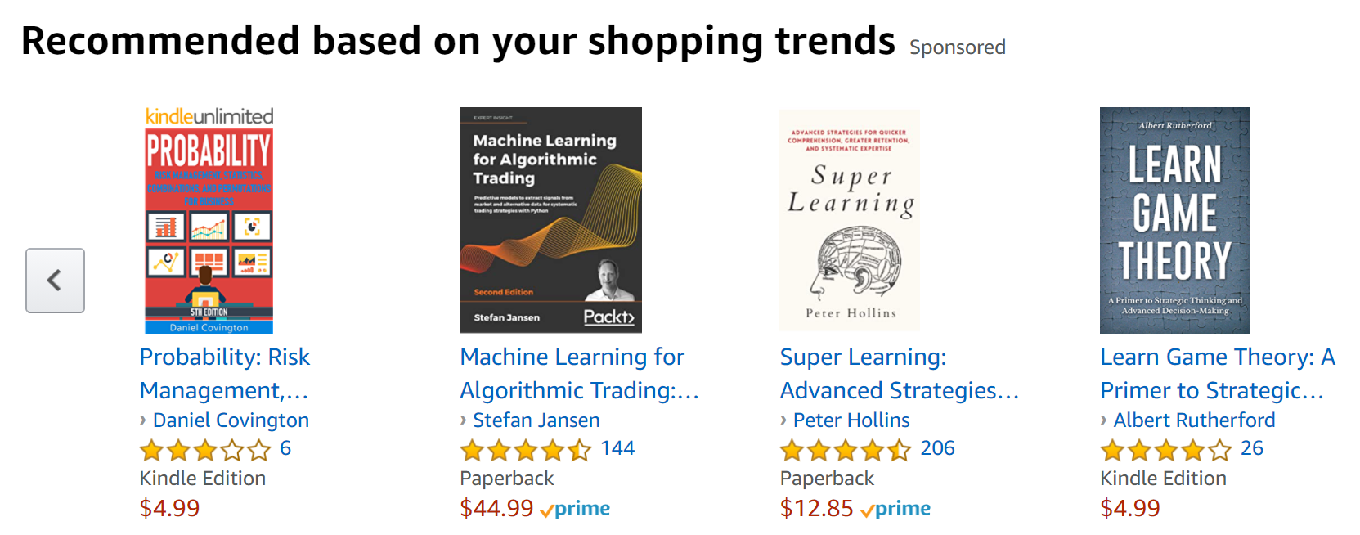
Recommendation System

Slide 11
Association Rules & Recommendation System
Goal: Produce rules that define “what goes with what”
Example: “If X was purchased, Y was also purchased” or “Our records show you bought X, you may also like Y”
Rows are transactions/historic purchase/rating/browsing/preferences

Slide 12
Association Rules & Recommendation System
Association Rules (affinity analysis): rules for an entire population
Recommendation System (collaborating filtering): rules at the individual user level

Slide 13
Predictive analytics
Predictive analytics: the tasks of classification and prediction as well as pattern discovery
Classification, prediction, and to some extent, association rules and collaborative filtering constitute “predictive analytics”

Slide 14
Data Exploration
Data sets are typically large, complex & messy
Goal: Understand the global landscape of the data and detect unusual values
Techniques: Data Reduction and Data Visualization

Slide 15
Data Reduction
Consolidating complex/large data into simpler/smaller data
Reducing the number of records/rows (e.g., clustering)
Reducing the number of variables/columns (e.g., principal components)

Slide 16
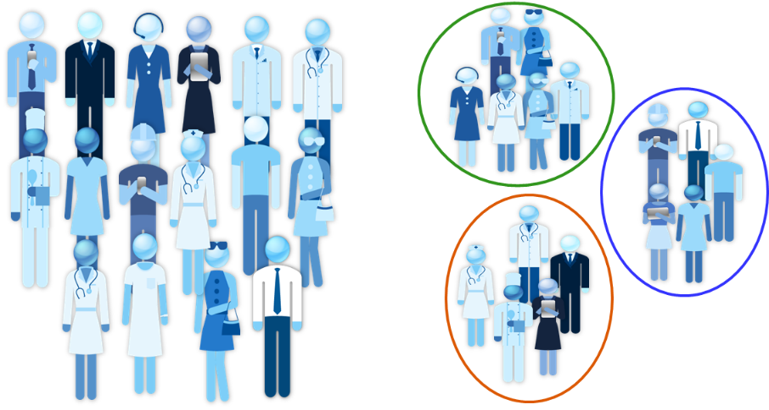
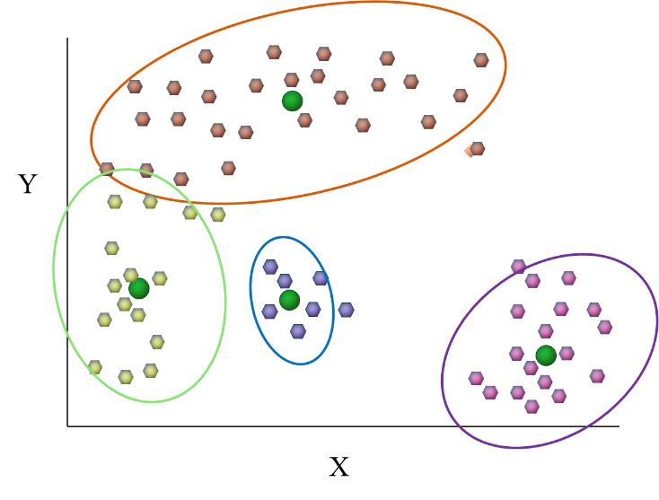
Data Reduction
Clustering: Reducing the number of cases/rows
e.g., K-means clustering

Slide 17
Data Visualization
Graphs and plots of data
Examine variable separately or the relationships between pairs of variables
Discover patterns or exceptions

Slide 18
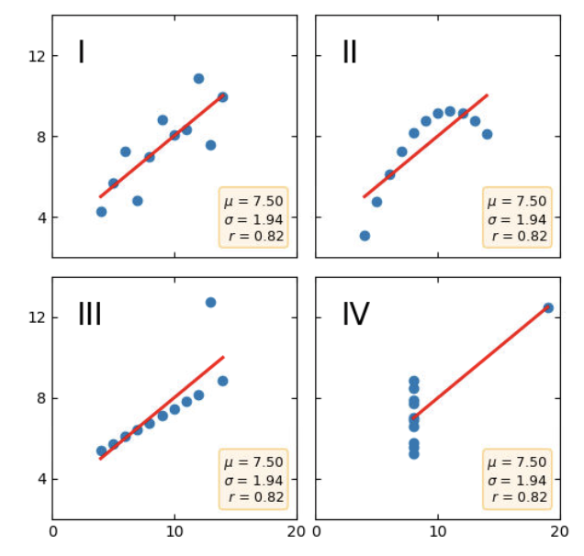
Data Visualization
Why Look at Data?
In Statistics courses, you learn how to calculate some measures, ratios, and statistics, such as:
Mean (μ)
Standard deviation (σ)
Median
Mode
Correlation coefficient (r)
Plots of Anscombe’s quartet

Slide 19
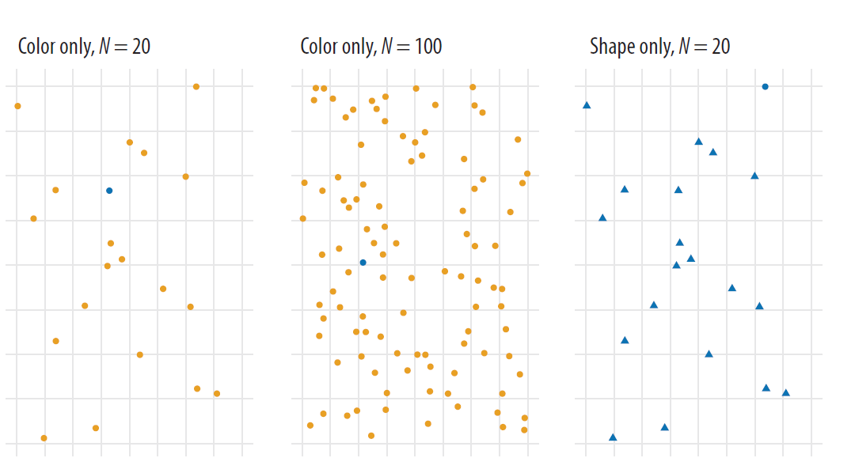
Data Visualization
Perception and Data Visualization
Searching for the blue circle becomes progressively harder.

Slide 20
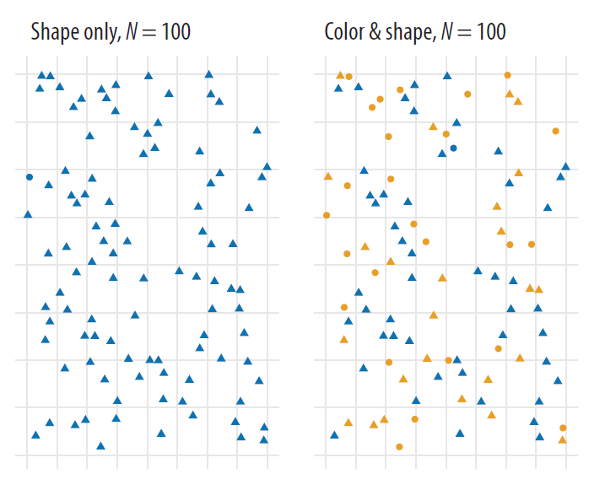
Data Visualization
Perception and Data Visualization
Shape and color are two distinct channels that can be used to encode information visually.
Pop-out on the color channel is stronger than it is on the shape channel.

Slide 21
Data Visualization
Numerical variables: Histograms, boxplots, outliers, scatterplots
Categorical variable: Bar charts

Slide 22
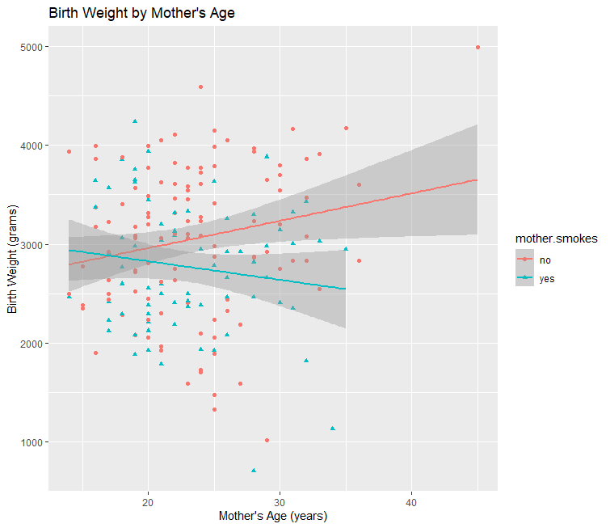
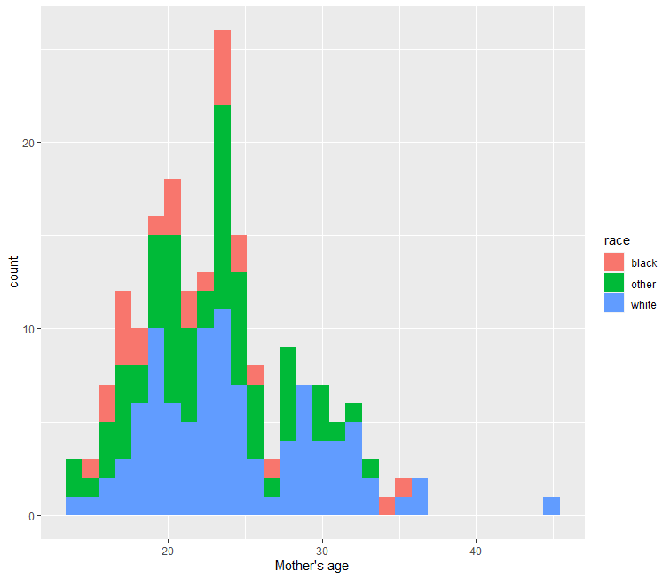
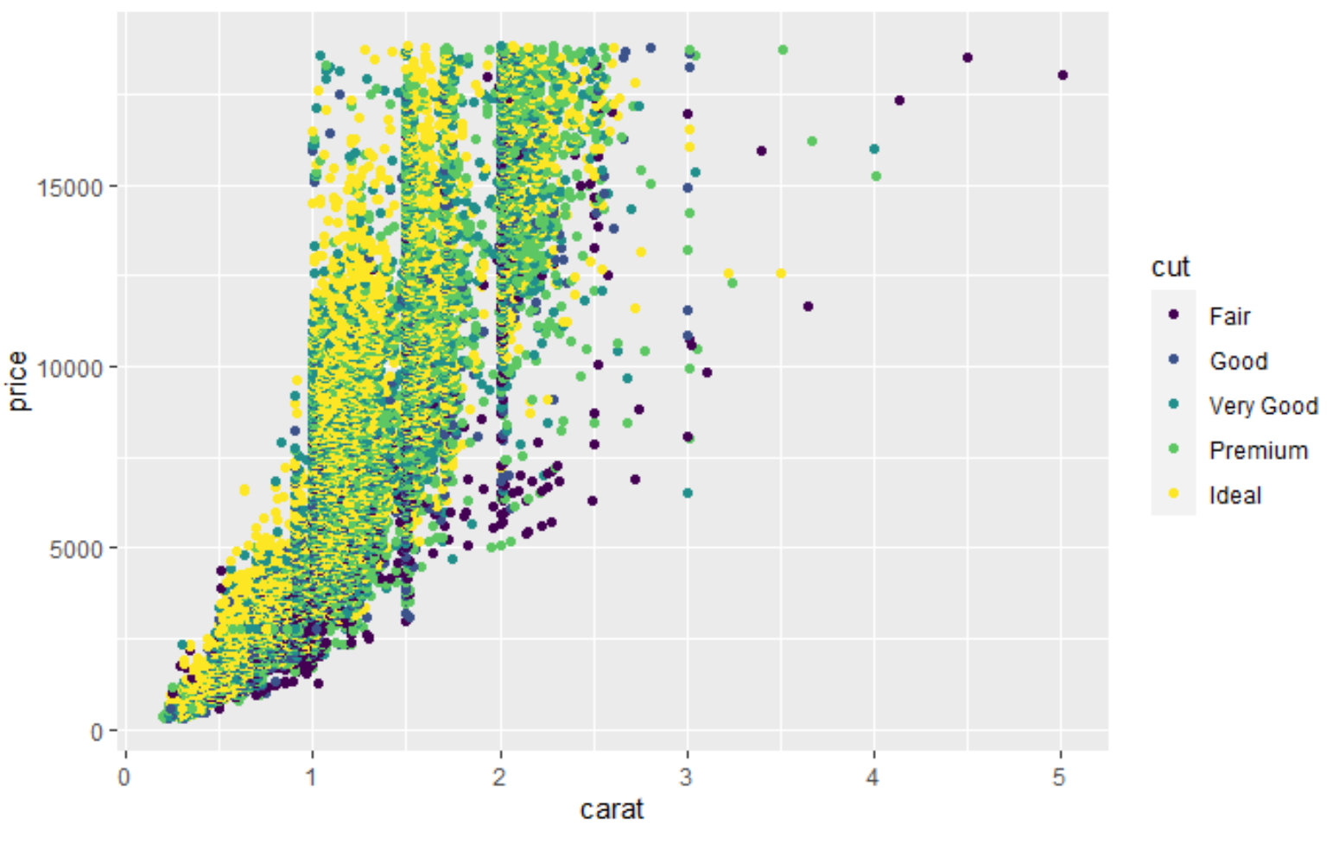
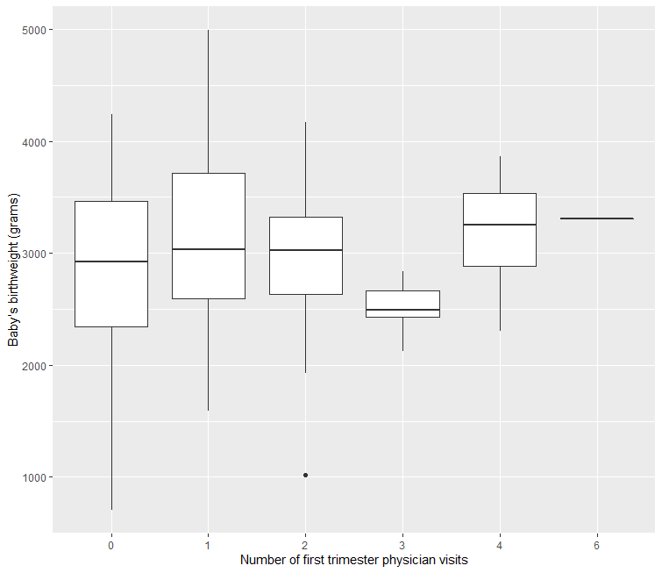
Data Visualization

Slide 23
Supervised Learning V.S. Unsupervised Learning

Slide 24
Data Mining Techniques
Supervised:
Classification
Prediction
Unsupervised:
Association Rules & Recommendation System
Data Exploration (Data Reduction & Visualization)

Slide 25
Supervised Learning
Goal: Predict or classify outcome variables
We must have “labeled data”: The value of the outcome of interest is known (e.g., purchase or no purchase)
Methods: Simple regression, Classification and Prediction
Algorithms
Model(s)
Training data
Validation data
Test data
The outcome is known
The outcome is known, but initially hidden
The outcome is known;
Model evaluation
Learning Process
New data
The outcome is unknown

Slide 26
Unsupervised Learning
Goal: Segment data into meaningful segments; detect patterns
There is no target (outcome) variable to predict or classify
Methods: Association rules, data reduction, data exploration, visualization, clustering

Slide 27
Supervised Learning & Unsupervised Learning
Both methods are sometimes used in conjunction
Example: separate loan applications (unsupervised clustering) and then predict loan default (supervised) at each risk-level group

Slide 28
Supervised? Unsupervised?
Deciding whether to issue a loan to an applicant based on demographic and financial data (with reference to a database of similar data on prior customers)
Identifying segments of similar customers
Predicting whether a company will go bankrupt based on comparing its financial data to those of similar bankrupt and nonbankrupt firms
Making recommendations to customers concerning additional items to buy based on the buying patterns in prior transactions

Slide 29
Next Topics
Introduction to R/RStudio

